Slide 1

TEAM-14
EKLAVYA
DRONACHARYA EDUCATIONAL APP

Slide 2

TEAM MEMBERS
Abhinash Gunda
Neeraj Yadu
Aditya Jethani
Shrey Pachauri
Avishka Karn
Vaishnavi Shukla
Thynk Unlimited

Slide 3

PROBLEM STATEMENT
Comprehensive platform for data management
Track student progress and stages
List courses, universities, fellowships
Connect students with mentors
Conduct tests and show results
Analyze test scores, attendance, applications
.

Slide 4





TECHSTACK USED
Flutter
Node.js
Mongo DB
Python
Pandas

Slide 5
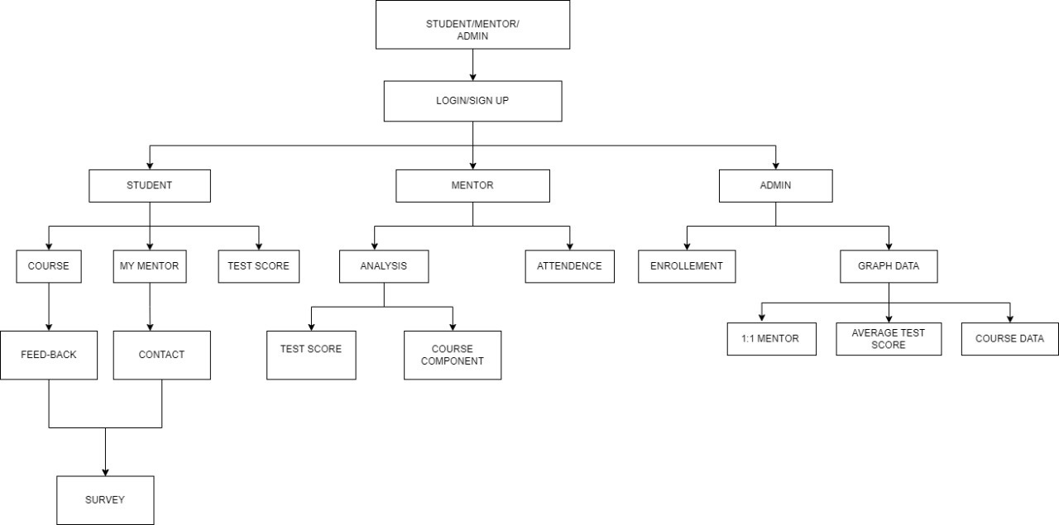
FLOW CHART

Slide 6

ADDRESSING THE PROBLEM
01
STUDENT
Courses and Learnings
Test and Assessments
Mentor Interaction
02
MENTOR
Data Analysis
Attendance Insights
Student Progress Tracking
03
ADMIN
Holistic Metrics
Monitoring Performance

Slide 7

KEY FEATURES
01
CROSS PLATFORM COMPATABILITY
02
DATA INSIGHTS AND ANALYSIS
03
END TO END USER TRACKING

Slide 8
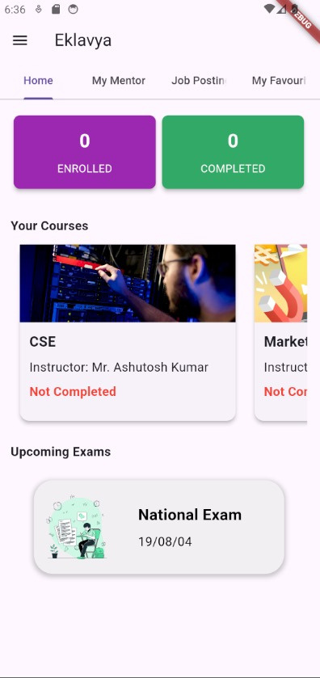
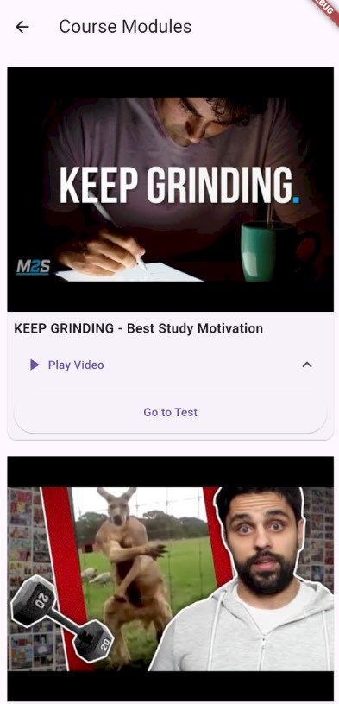
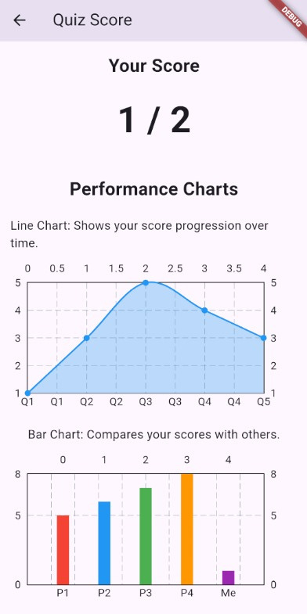
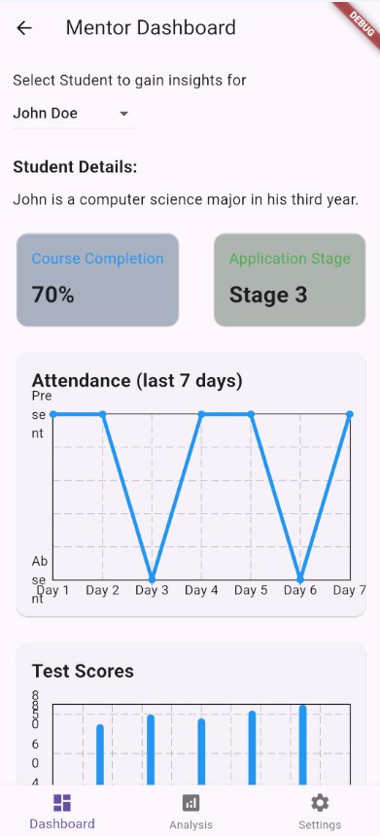
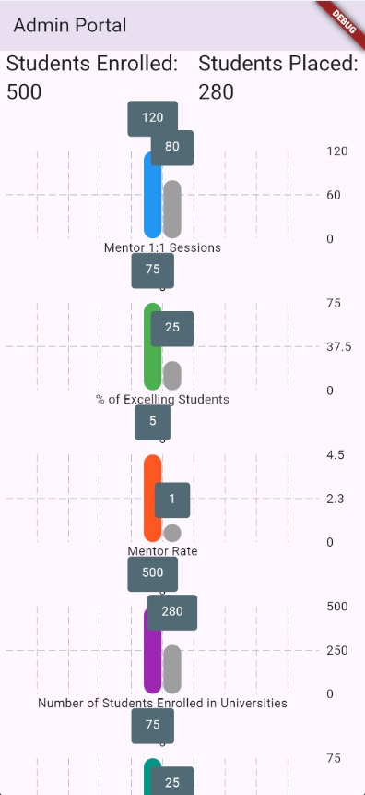
OVERVIEW

Slide 9

FUTURE SCOPE
01
MENTOR-STUDENT CHAT APPLICATION
02
ALUMINI CONNECT
03
GAMIFICATION AND REWARDS
04
LANGUAGE TRANSLATION

